Slide 1
MOVIES ON STREAMING PLATFORMS
Team Members: AnnMarie Morrison, Mercy Griffin, Taniya Chhabra

Slide 2

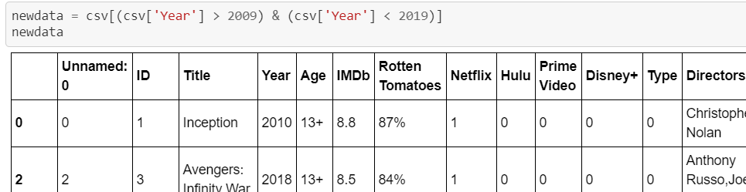
Cleaned Our Data
We obtained our data from Kaggle, before we cleaned the data to only look at the years of 2009 - 2019, there were over 16,000 rows of data; we cleaned the data and limited it down to only 9,000 rows of data.

Slide 3


Which streaming platform has the most movies?

Slide 4
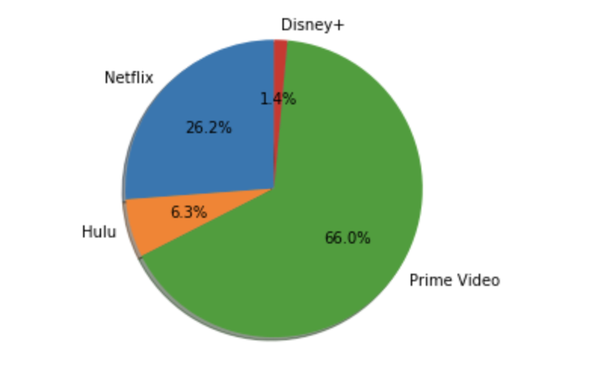
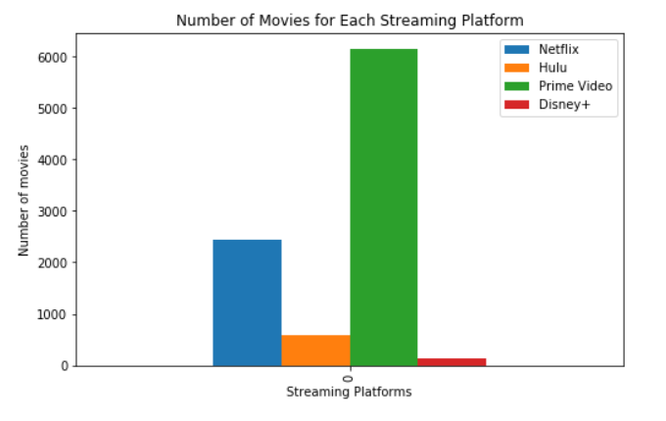

Slide 5
Which streaming platform has the greatest number of popular movies?

Slide 6

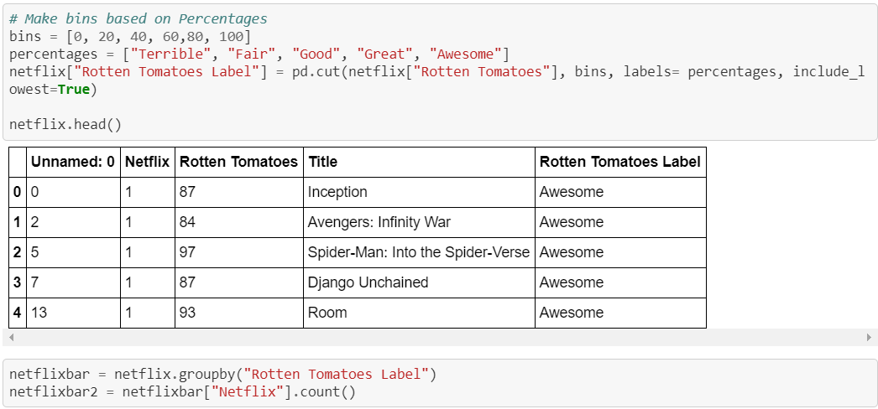
How did we organize the data
We created bins and labels for both rating service, then created bar graphs to see which service had the greatest number of popular movies

Slide 7
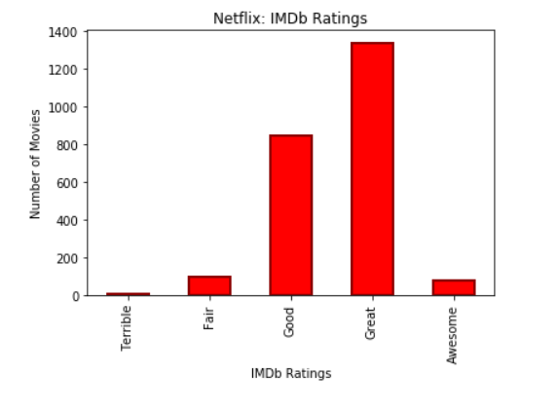
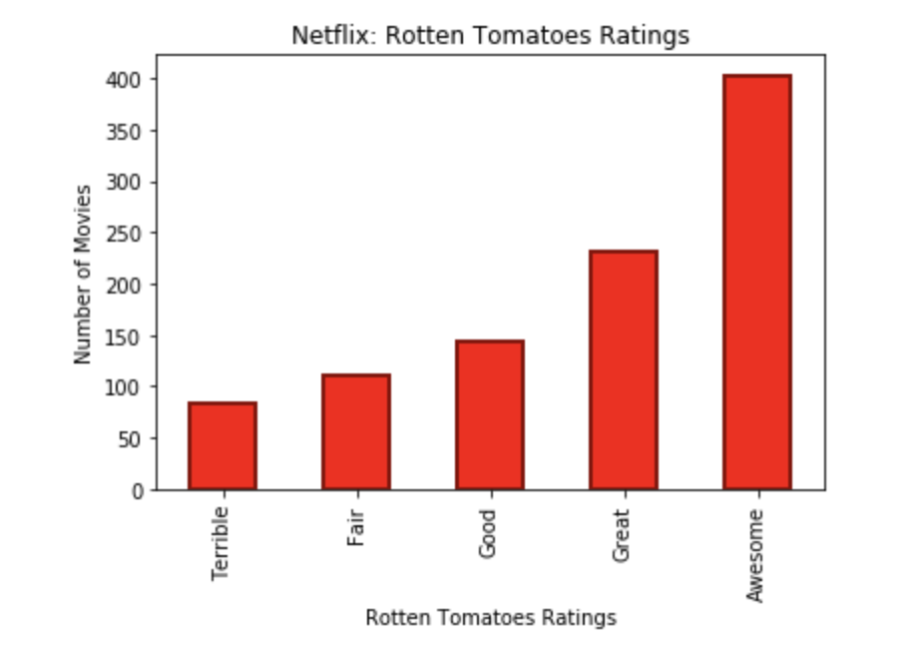
Netflix Ratings

Slide 8
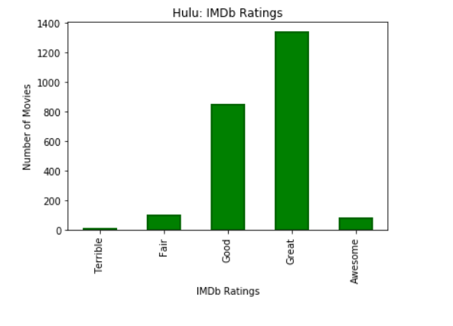
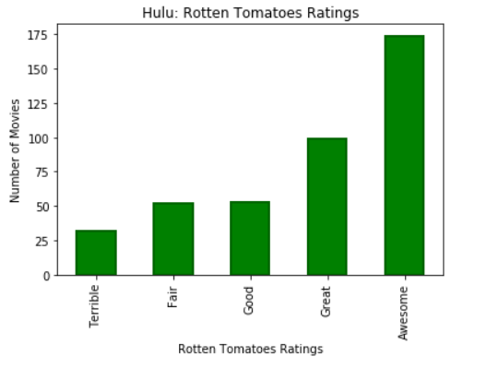
Hulu Ratings

Slide 9
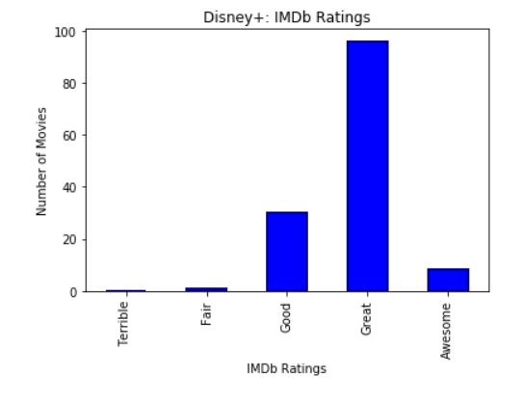
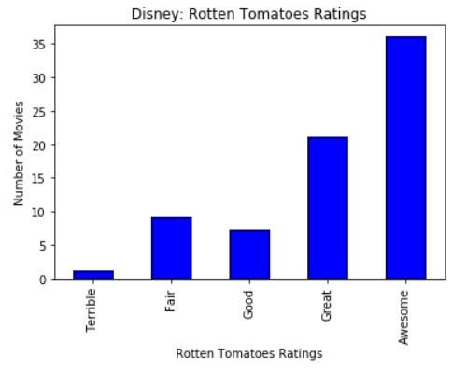
Disney+ Ratings

Slide 10
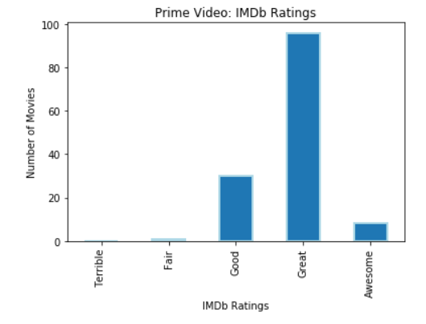
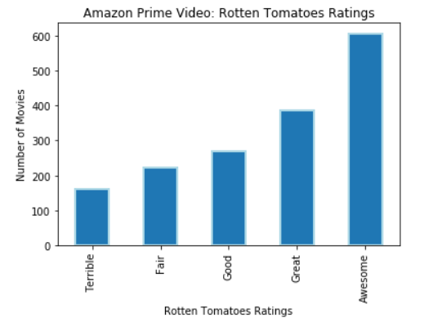
Amazon Prime Video Ratings

Slide 11
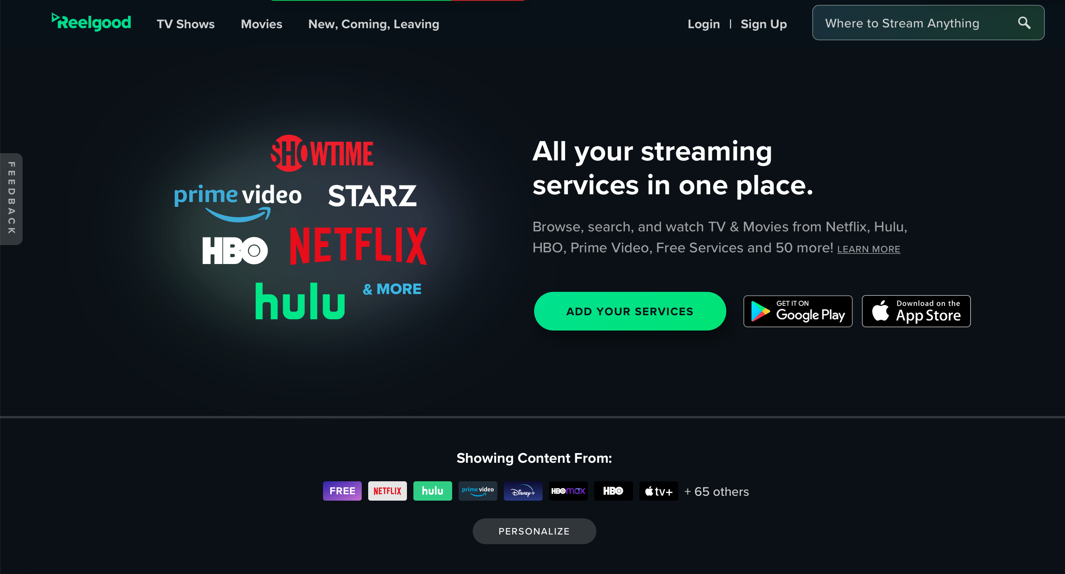
Limitations

